Slide 1
AI3067 深度学习及应用大作业 任务 B：LAPGM
蒋伟
2022/12/20

Slide 2
图匹配算法
二次分派问题（传统）：Matrix ⬄ Matrix
线性分派问题（Permutation）：Vector ⬄ Vector / Set ⬄ Set
压缩表示图的连接关系
问题更简单易解
效果更好

Slide 3
主要工作
学习 PCA-GM，IPCA-GM，CIE 等图匹配方法
基于 Jittor：
实现一个兼容性高，用户友好的（图匹配）神经网络训练器和管线
适配多种图匹配数据集和方法
通过实验
初步证明训练器的可用性、易用性、泛用性
复现或尽可能提高现有图匹配方法的性能
消融实验
对比不同超参数、训练设计对性能的影响
对比是否 finetune 预训练 Backbone 的效果

Slide 4
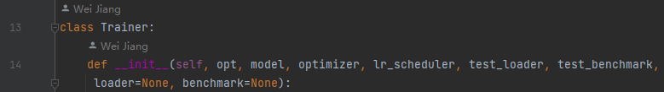
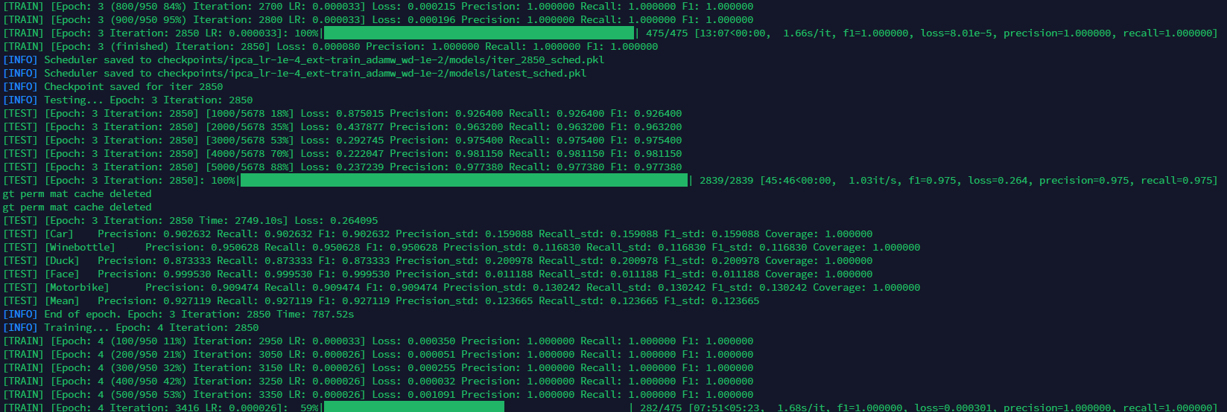
神经网络训练器
模块化/可定制
epoch，batch，eval，
cal_metrics，intervals
自动化
logging，checkpoints
可视化
训练/测试进度，TensorBoard

Slide 5
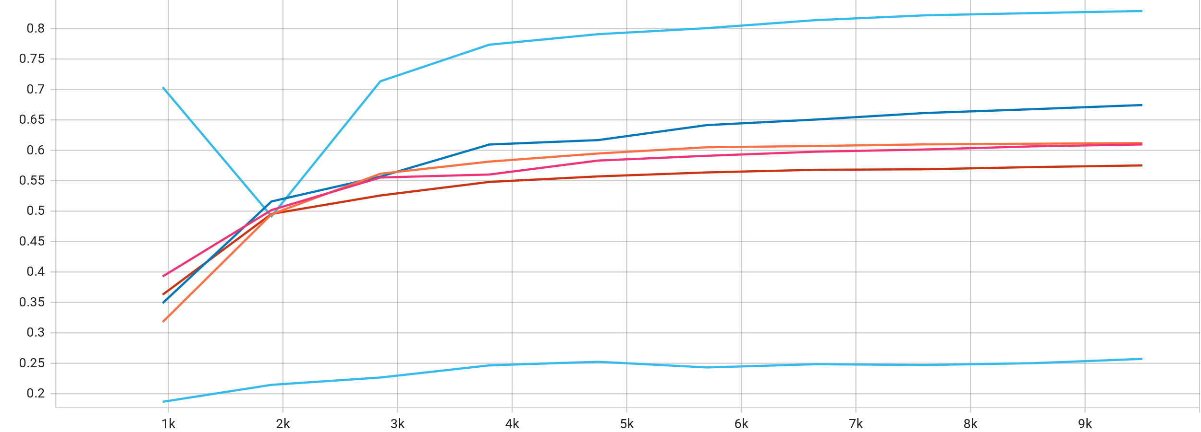
数据集和方法适配
WillowObject，PascalVOC（小建议：pairs.npz 下载集成）
PascalVOC：outliers，few kpts，
尚未完成
PCA-GM，IPCA-GM，CIE
过拟合：Weight Decay！
Hungarian Attention（TP+FP+FN）
Test loss. Overfitting is obvious.
[TEST] [Car] Precision: 0.898947 Recall: 0.898947 F1: 0.898947 Precision_std: 0.145091 Recall_std: 0.145091 F1_std: 0.145091 Coverage: 1.000000 [TEST] [Motorbike] Precision: 0.944737 Recall: 0.944737 F1: 0.944737 Precision_std: 0.118981 Recall_std: 0.118981 F1_std: 0.118981 Coverage: 1.000000 [TEST] [Duck] Precision: 0.916782 Recall: 0.916782 F1: 0.916782 Precision_std: 0.157184 Recall_std: 0.157184 F1_std: 0.157184 Coverage: 1.000000 [TEST] [Face] Precision: 1.000000 Recall: 1.000000 F1: 1.000000 Precision_std: 0.000000 Recall_std: 0.000000 F1_std: 0.000000 Coverage: 1.000000 [TEST] [Winebottle] Precision: 0.938937 Recall: 0.938937 F1: 0.938937 Precision_std: 0.123009 Recall_std: 0.123009 F1_std: 0.123009 Coverage: 1.000000 [TEST] [Mean] Precision: 0.939881 Recall: 0.939881 F1: 0.939881 Precision_std: 0.108853 Recall_std: 0.108853 F1_std: 0.108853
Best PCA-GM result till now. With weight decay of 0.01.
[TEST] [Winebottle] Precision: 0.936522 Recall: 0.936522 F1: 0.936522 Precision_std: 0.130771 Recall_std: 0.130771 F1_std: 0.130771 Coverage: 1.000000 [TEST] [Car] Precision: 0.955790 Recall: 0.955790 F1: 0.955789 Precision_std: 0.101272 Recall_std: 0.101272 F1_std: 0.101272 Coverage: 1.000000 [TEST] [Motorbike] Precision: 0.955263 Recall: 0.955263 F1: 0.955263 Precision_std: 0.107843 Recall_std: 0.107843 F1_std: 0.107843 Coverage: 1.000000 [TEST] [Duck] Precision: 0.928046 Recall: 0.928046 F1: 0.928046 Precision_std: 0.136271 Recall_std: 0.136271 F1_std: 0.136271 Coverage: 1.000000 [TEST] [Face] Precision: 0.991719 Recall: 0.991719 F1: 0.991719 Precision_std: 0.046304 Recall_std: 0.046304 F1_std: 0.046304 Coverage: 1.000000 [TEST] [Mean] Precision: 0.953468 Recall: 0.953468 F1: 0.953468 Precision_std: 0.104492 Recall_std: 0.104492 F1_std: 0.104492
Best CIE result till now. With weight decay of 0.01 but without Hungarian Att..
Notes:
Hungarian Attention 把 loss 集中在了更有价值的位置，可能需要配合更大的学习率。

Slide 6
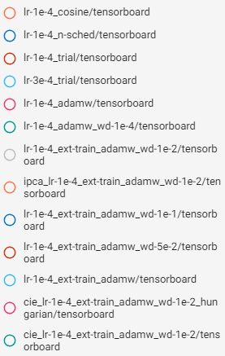
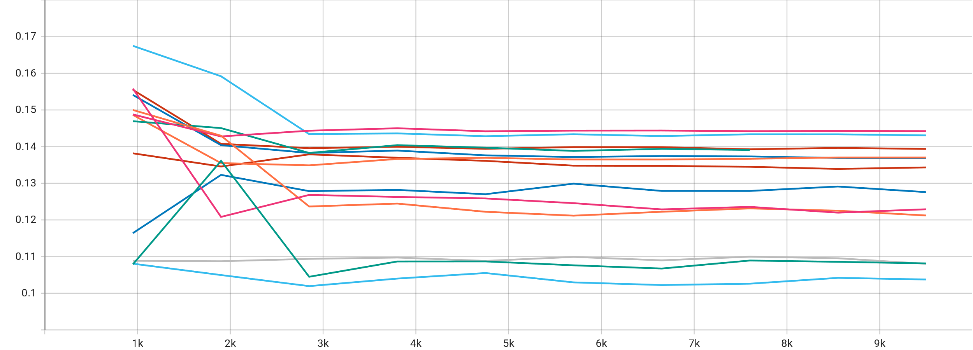
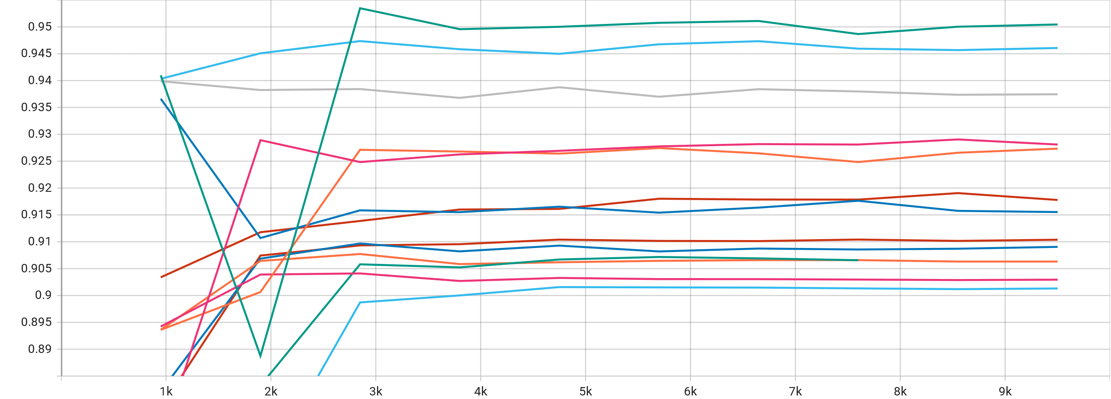
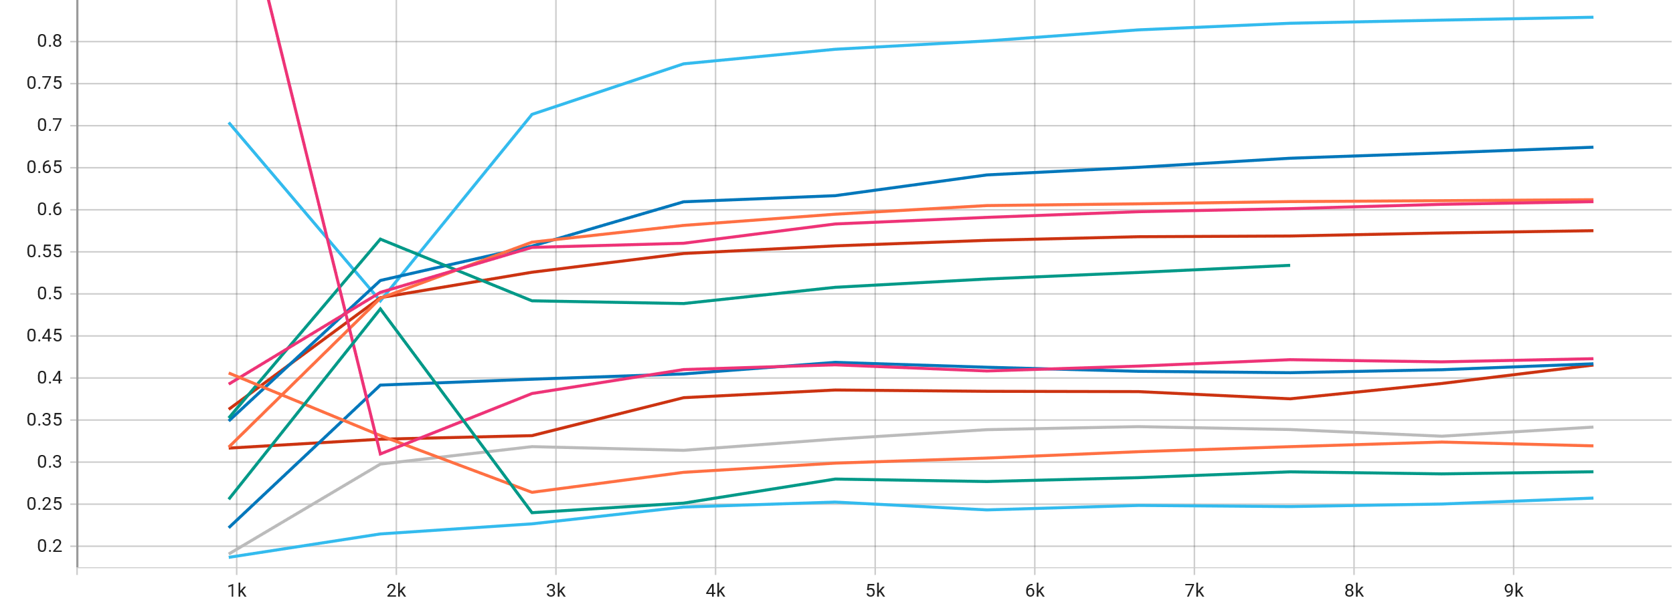
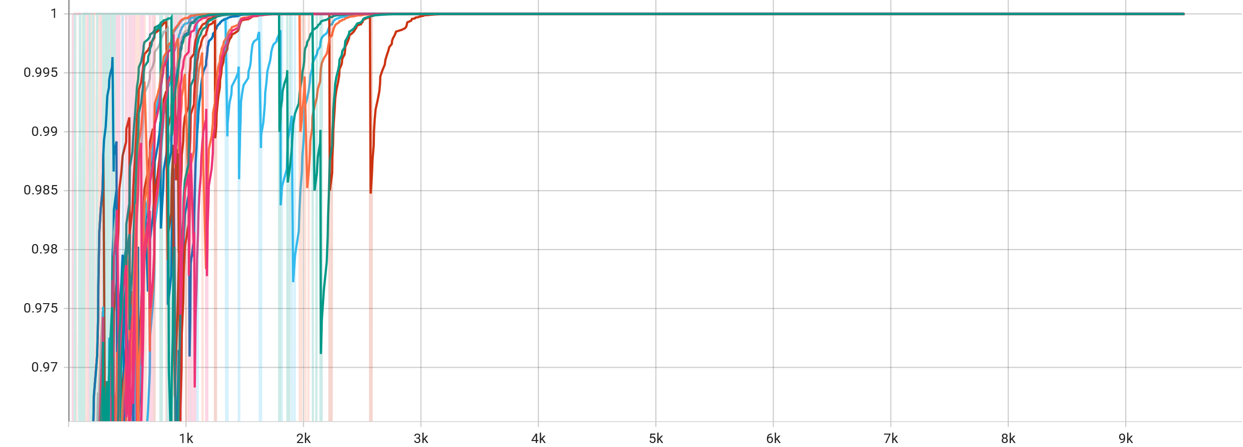
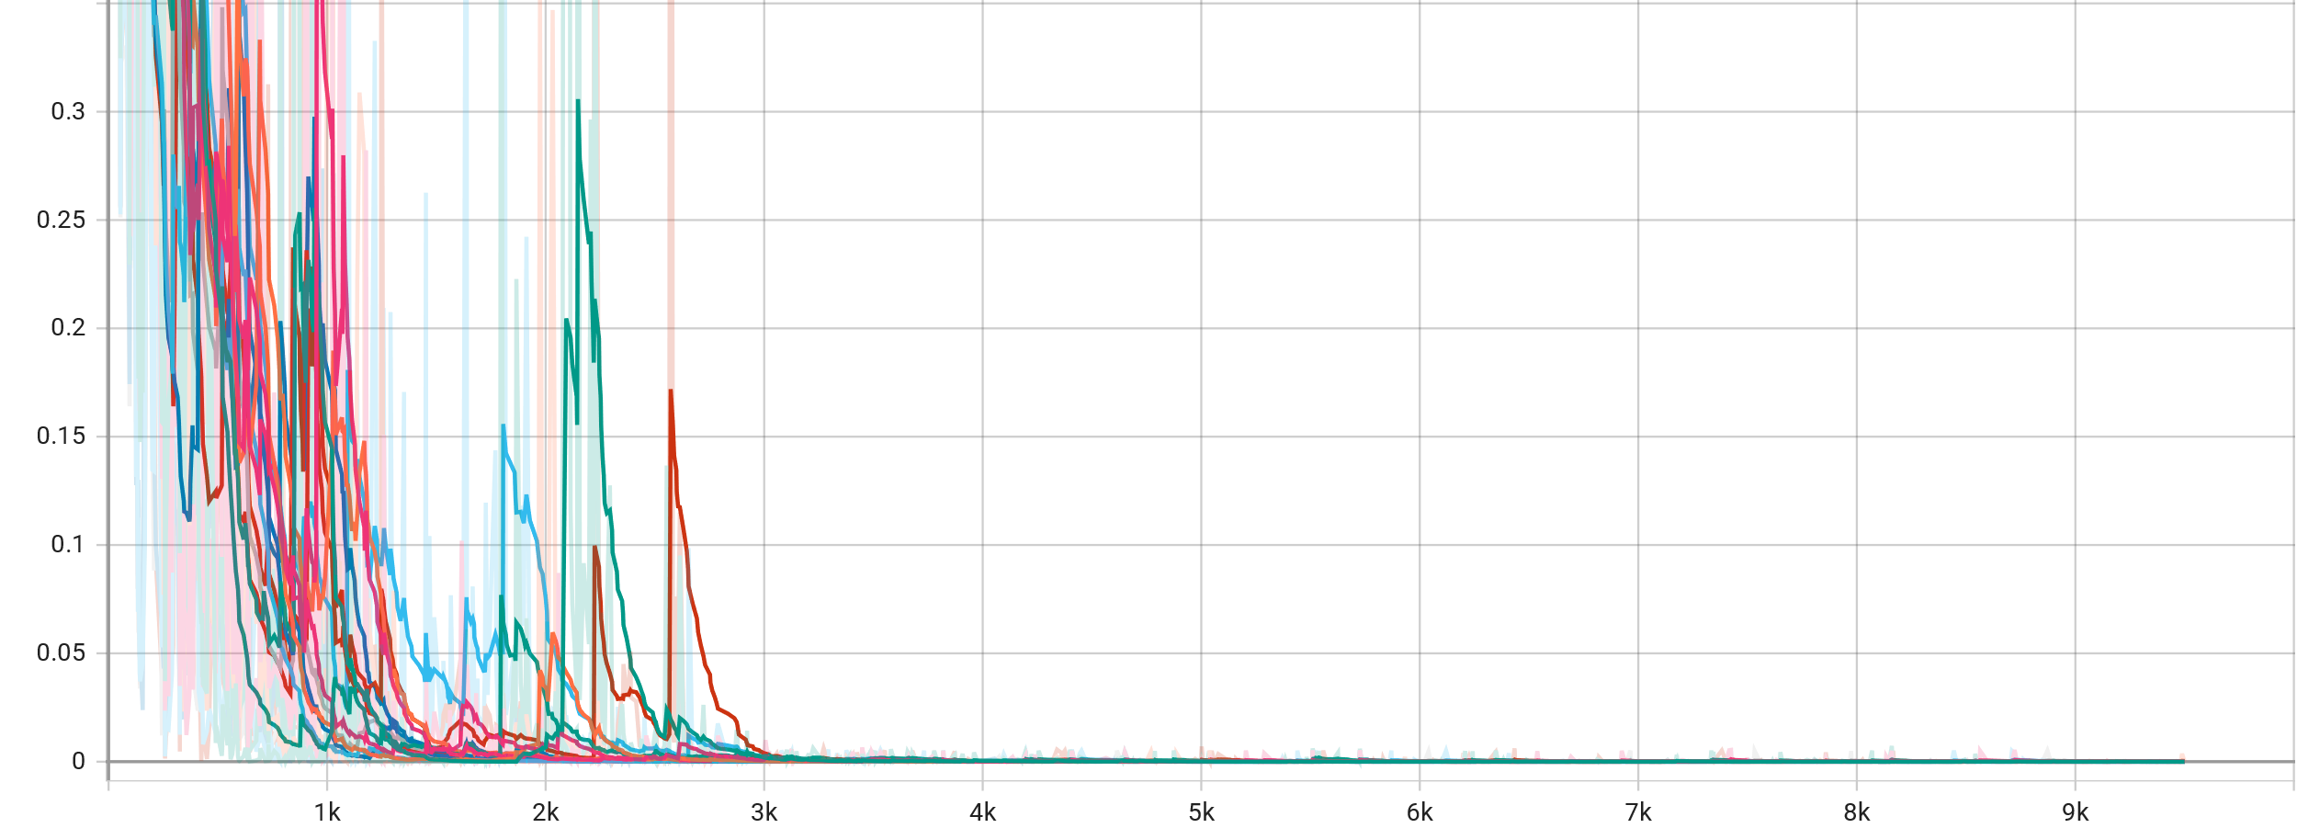
实验结果（部分）
Test f1 score standard.
Test f1 score.
Test loss.
Train f1 score. (Smoothed.)
Traine loss. (Smoothed)

Slide 7
实验结论（部分）
Finetuning：finetune Backbone 能有效提高性能。
优化器：AdamW 比 SGD 更稳定，效果更好。
Scheduler：StepLR 优于 CosineAnnealing 和不 schedule。
学习率：1e-4 是训练较稳定，收敛结果好的学习率。
Weight Decay：1e-2 平衡了过拟合和学习能力。
Hungarian Attention：在一些情况下会导致性能下降。
方法对比：CIE > PCA-GM > IPCA-GM。
Notes:
CosineAnnealing：余弦退火。
IPCA 和 PCA 的差异可能是超参数设置问题 。

Slide 8
其他
# select scope up to extractor training mode if self.is_training() and extractor_train: self.extractor.train() scope = jittor.enable_grad else: self.extractor.eval() scope = jittor.no_grad with scope(): # extract image features feat = self.extractor(img) # B, G, F, H, W # get node features feat = feat.reshape(-1, *feat.shape[2:]).permute(0, 2, 3, 1) # BG, H, W, F rounded_kpt = jittor.round(kpt).long() # B, G, 2, N rounded_kpt = rounded_kpt.permute(0, 1, 3, 2) # B, G, N, 2 rounded_kpt = rounded_kpt.reshape(-1, *rounded_kpt.shape[2:]) # BG, N, 2 node = feat.gather(1, rounded_kpt[:, :, 1]) # BG, N, H, F node = node.gather(2, rounded_kpt[:, :, 0, None]) # BG, N, 1, F node = node.reshape(*img.shape[:2], -1, node.shape[-1]) # B, G, N, F # get edge features Q = None if self.edge_feature: kpt_dis = kpt.unsqueeze(3) - kpt.unsqueeze(4) # B, G, 2, N, N kpt_dis = jittor.norm(kpt_dis, p=2, dim=2) # B, G, N, N Q = jittor.exp(-kpt_dis / img.shape[-1]).unsqueeze(-1).float32() # B, G, N, N, 1 # match graphs pred, pred_matching = self.gm(node, A, Q) # B, N, N # compute loss if tgt is not None: if self.hungarian_attention: Z = (pred_matching + tgt).bool().float32() pred.register_hook(lambda grad: grad * Z) loss = pygm.utils.permutation_loss(pred, tgt) return pred, pred_matching, loss return pred, pred_matching
模型：
矩阵化运算：避免循环
为预训练 Backbone（VGG）自动设置梯度

Slide 9
鸣谢
严老师、汪学长、各位助教的指导、帮助。
张文浩同学在初期调试的帮助。
参考文献
[1] L. Bourdev and J. Malik. Poselets: Body part detectors trained using 3d human pose annotations. In
International Conference on Computer Vision, pages 1365–1372. IEEE, 2009.
[2] Minsu Cho, Karteek Alahari, and Jean Ponce. Learning graphs to match. In International Conference on
Computer Vision, pages 25–32, 2013.
[3] Mark Everingham, Luc Van Gool, Christopher KI Williams, John Winn, and Andrew Zisserman. The pascal
visual object classes (voc) challenge. International Journal of Computer Vision, 88:303–338, 2010.
[4] Karen Simonyan and Andrew Zisserman. Very deep convolutional networks for large-scale image recognition.
arXiv preprint arXiv:1409.1556, 2014.
[5] Runzhong Wang, Junchi Yan, and Xiaokang Yang. Combinatorial learning of robust deep graph matching:
an embedding based approach. IEEE Transactions on Pattern Analysis and Machine Intelligence, 2020.
[6] Tianshu Yu, Runzhong Wang, Junchi Yan, and Baoxin Li. Learning deep graph matching with channel-
independent embedding and hungarian attention. In International Conference on Learning Representations,
2020.

